Slide 1
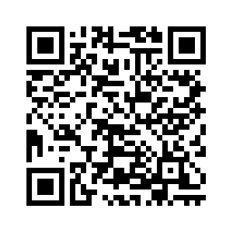
The Plastic Masons
Peter Davis, Ato Koomson, Huyen Pham
Please scan this QR code to take our pre survey

Slide 2
What Is TAP?
TAP is an outreach program for students to connect with all ages through projects.
These projects are supposed to be fun and engaging while being educational.
It is intended to build leadership, communication, and technical skills in program participants.
We want to increase the number of students in the ITEC concentrations

Slide 3
Goal Of Our Project
We want to foster a basic level of 3D modeling literacy in all ages through an engaging project that has students actively doing what they’re being taught.
This project is intended for all ages, we believe that anyone can do it
We want every attendee to walk out of our workshop having drawn a 3D object

Slide 4
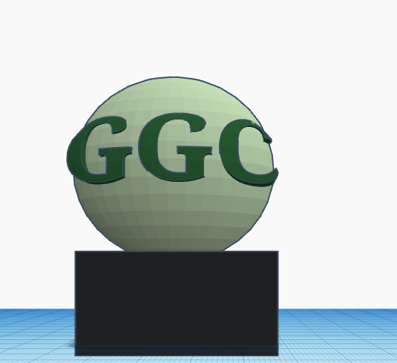
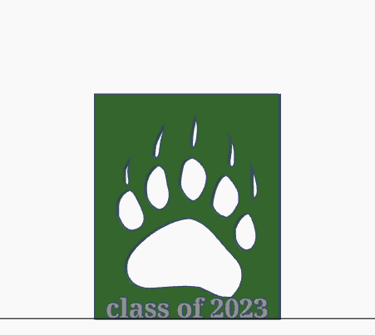
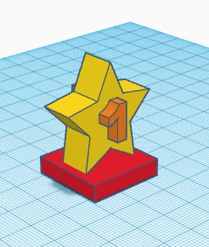
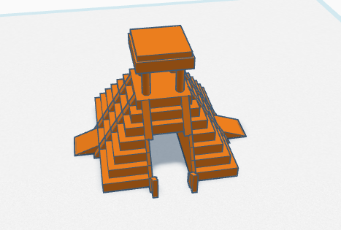
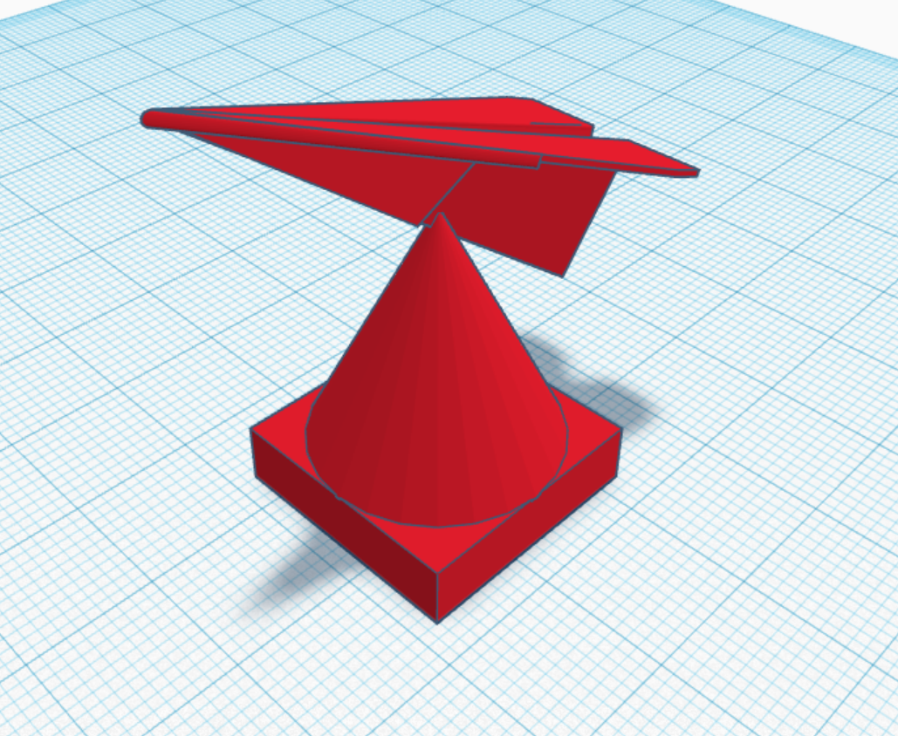
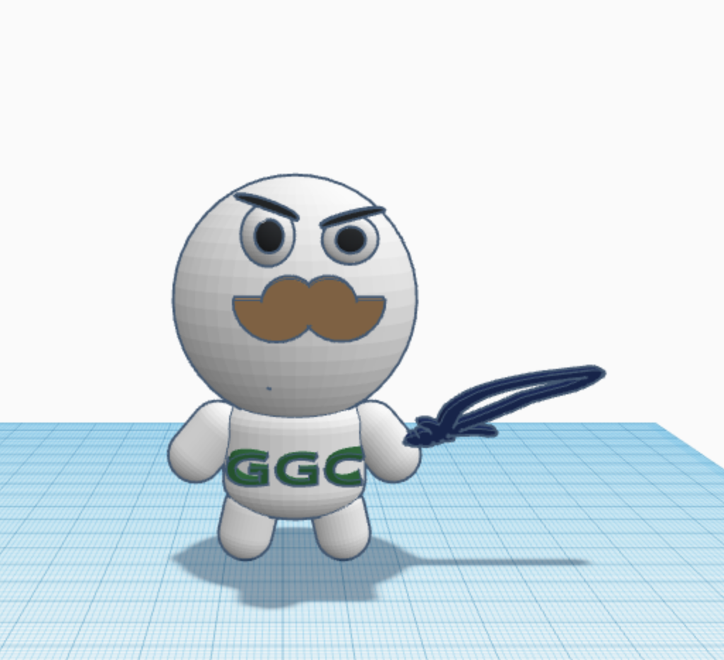
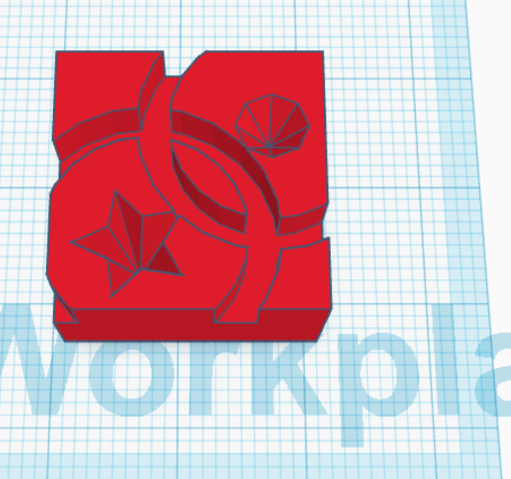
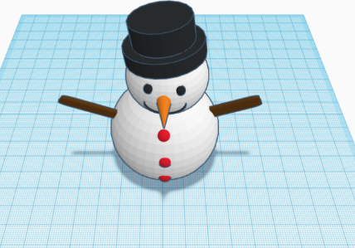
3D Design Showcase

Slide 5
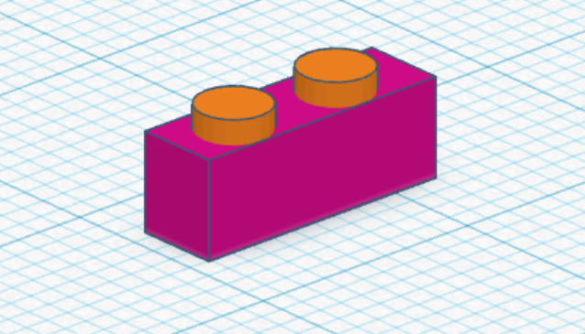
TinkerCAD
Simplified, browser-based CAD software
Much shallower learning curve than AutoCAD, Onshape, or Blender

Slide 6
The Workshop Itself
Presenting our 3D model in TinkerCAD
Demonstrate TinkerCADs controls
Demonstrate how we made the model

Slide 7
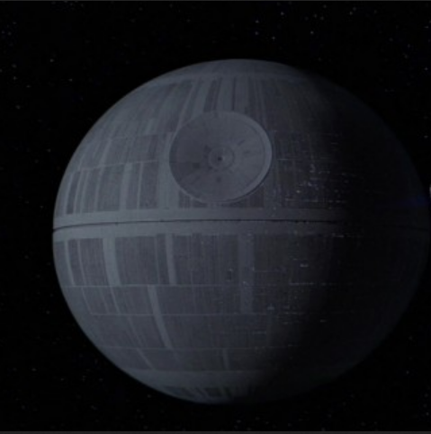
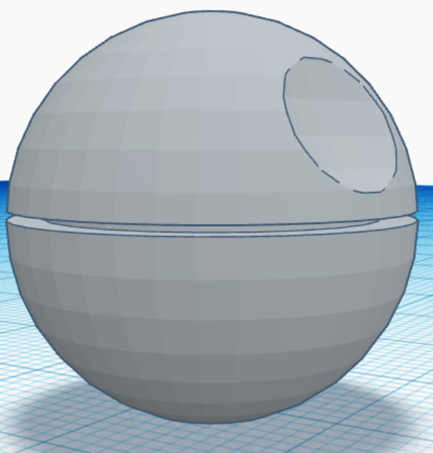
Our Model

Slide 8
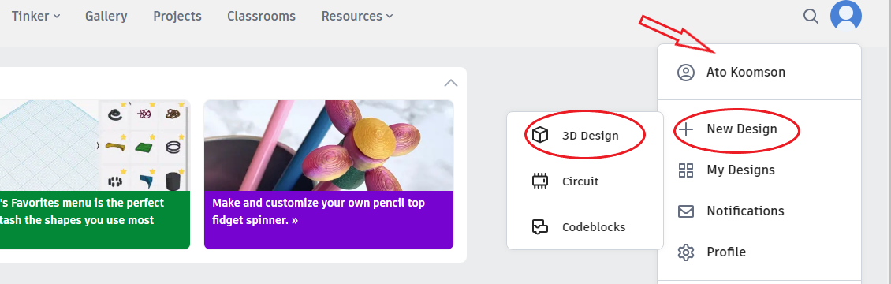
Step 1: Creating Your Tinkercad Account
Go to https://tinkercad.com and create a free account
Press the Create button to start creating a new 3D design

Slide 9
How 3D Printing Works
To understand 3D modeling, we should see how printing works
3D printers deposit a special kind of plastic called PLA in tiny layers
For a visual demonstration, you can watch a timelapse video of a 3D printer in action here.
https://www.youtube.com/watch?v=FqQAjkZOBeY
Timelapse of a 3D printer in action

Slide 10
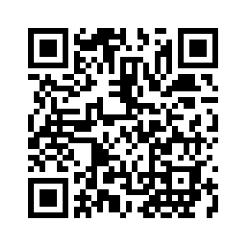
Any Questions?
Please scan the QR code to take our post survey

Slide 11
Workshop 2
If time allows

Slide 12
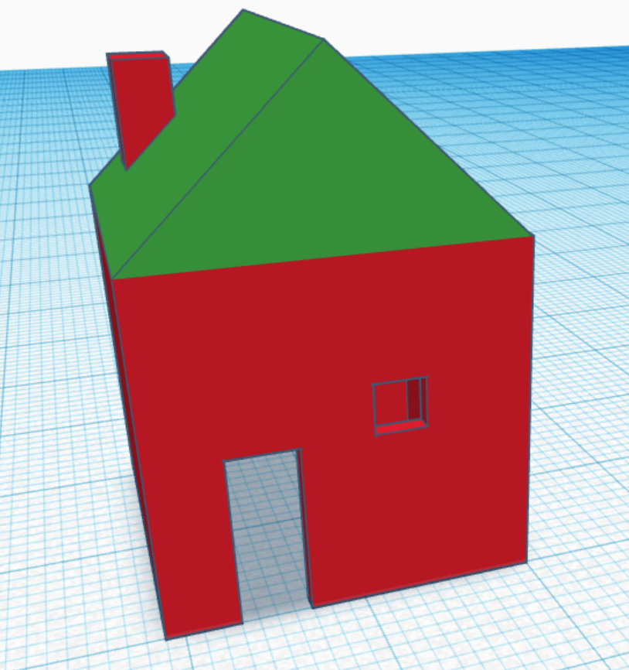
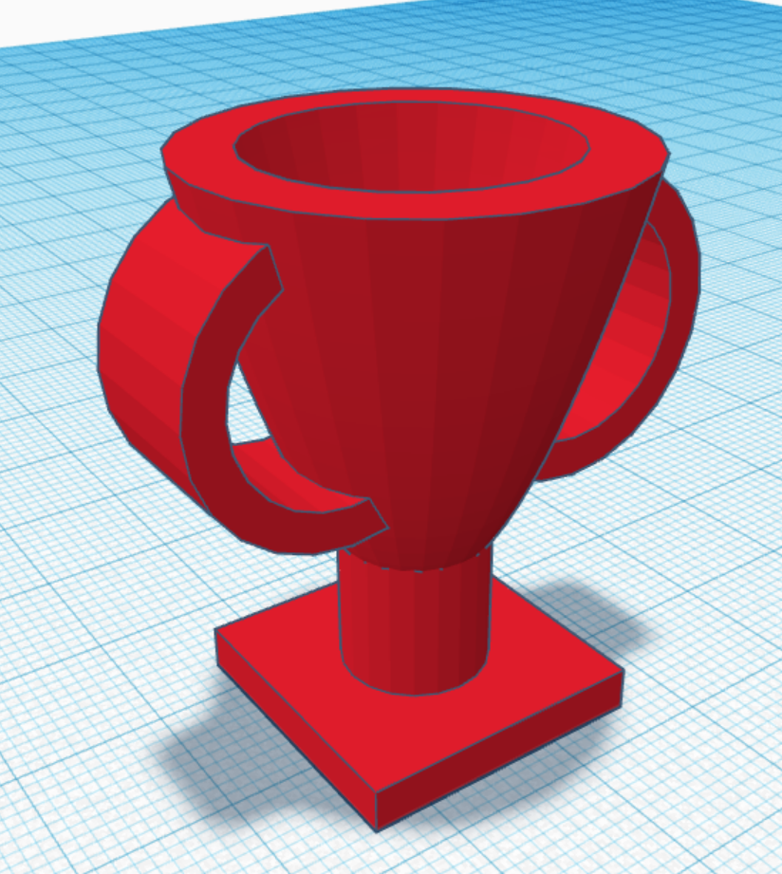
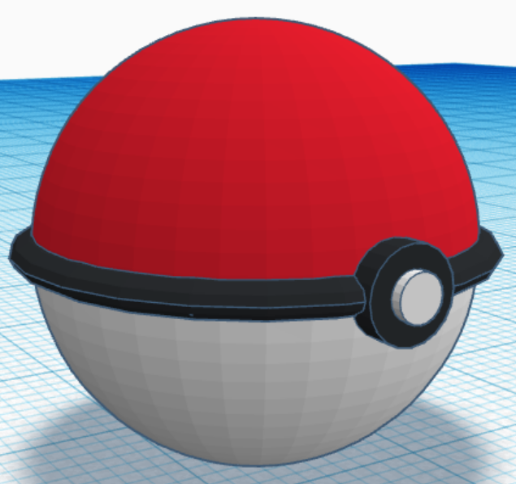
Vote On the Next Design

Slide 13
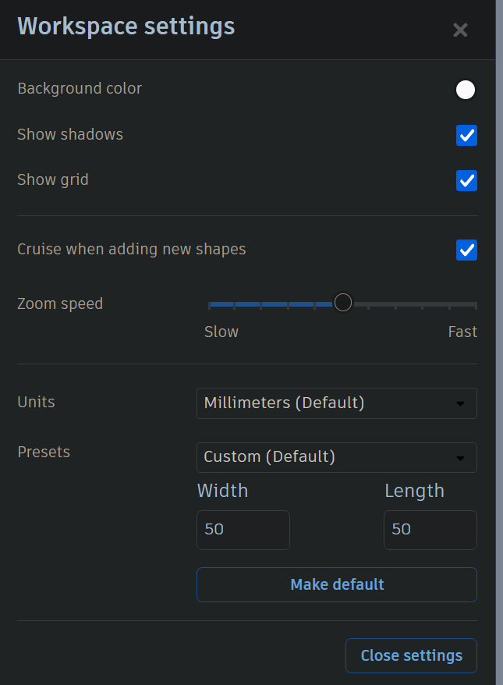
Grid Resizing
Click Setting at the bottom right corner of the screen and set the length and width of the grid to 50mm and click “Make Default”.
You can close the settings panel, you are ready to create

Slide 14
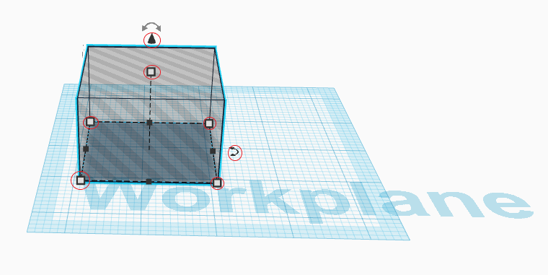
Step 3: Scaling and Shaping Objects
Select any shape with a flat base and drag it to where you want it on the grid. Use the handles on the corners and edges to scale it to size. The cube in the top left corner of your screen allows you to change viewing angles.
You can adjust elevation with the cone floating above your shape and tilt with the curved arrows, but the flat base should stay flat and flush against the grid.
You can use the scroll wheel on your mouse to zoom in and out, and the F key on your keyboard to center the object on your screen.
Notice the flat base flush with the workspace

Slide 15
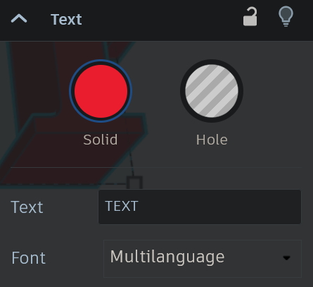
Text
Text can be found under basic shapes
When you place it, you will have the opportunity to edit the message
After that, you can treat it like a normal shape

Slide 16
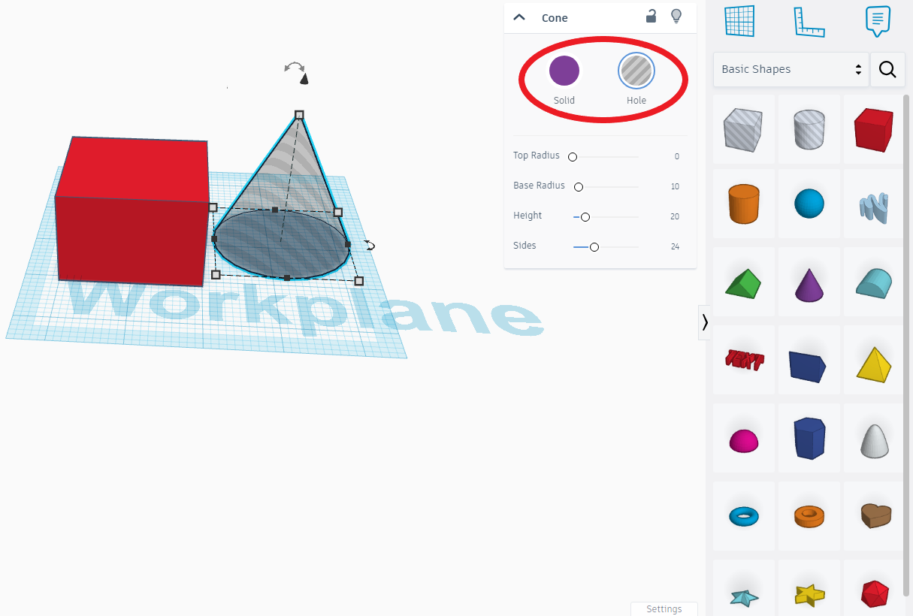
Step 4: Adding and Adjusting Objects
To add objects to your 3D design, you can use the basic shapes available in TinkerCAD's shape library. You can access the shape library on the right side of the screen. Click on the shape you want to add, and it will appear on your workspace.
To position and modify these objects, click and drag them to your desired location. You can also utilize the handles to resize and rotate the objects, tailoring them to fit your design precisely.
These shapes can be both additive and subtractive. When an object is selected, you can select “Solid” or “Hole”. This allows you to add or remove material in the shape of the selected object.

Slide 17
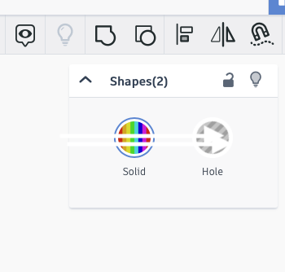
Combining Objects
To combine objects, hold shift and click on each shape you want to combine
When you’ve selected all the shapes you want to combine, click the fused square and circle button next to the light bulb at the top right of your screen.
To undo the grouping, there is an “Ungroup” button to the right of the “Group” button

